Slide 1






SMART ENVIRONMENTAL MONITORING WITH
SOLAR ENERGY CHARGING SYSTEM
Under the Guidance of
Dr. Sathish K.R, ME, Ph.D.
Assistant Professor, Department of EEE
ATMECE, Mysuru
Presented By:
Mohammed Suhail - 4AD18EE019
Manoj Kumar K S - 4AD18EE017
Madhu Gowda H K - 4AD18EE015
Vinod H V - 4AD18EE028

Slide 2
Contents
1
INTRODUCTION
6
DESIGN ASPECTS
2
PROBLEM DEFINITION
7
APPLICATIONS & REFERENCE
3
PROJECT OBJECTIVE
8
BUDGET & TIMELINE
4
LITERATURE SURVEY
5
METHODOLOGY

Slide 3
INTRODUCTION
The level of pollution has increased with times by lot of factors like the increase in population, increased vehicle use, industrialization and urbanization which results in harmful effects on human wellbeing by directly affecting health of population exposed to it.
In order to monitor quality of air, a Wireless sensor network (WSN) based new framework is proposed which is based on data acquisition and transmission.
The parameters of the environment to be monitored are chosen as volume of CO, Humidity, Temperature, Pressure, Air quality of atmosphere.
The values of these parameters are transmitted by using Bluetooth to the remote monitoring area so that every person in the range of the system can check it over their smart phones.

Slide 4

PROBLEM DEFINITION
During past decades, as result of civilization and urbanization there is a huge growth in Polluting industries, open burning of leaves and solid waste, massive quantities of construction waste, substantial loss of forests and vehicles (particularly diesel-driven cars) on roads that give rise to health endangering pollution.

Slide 5
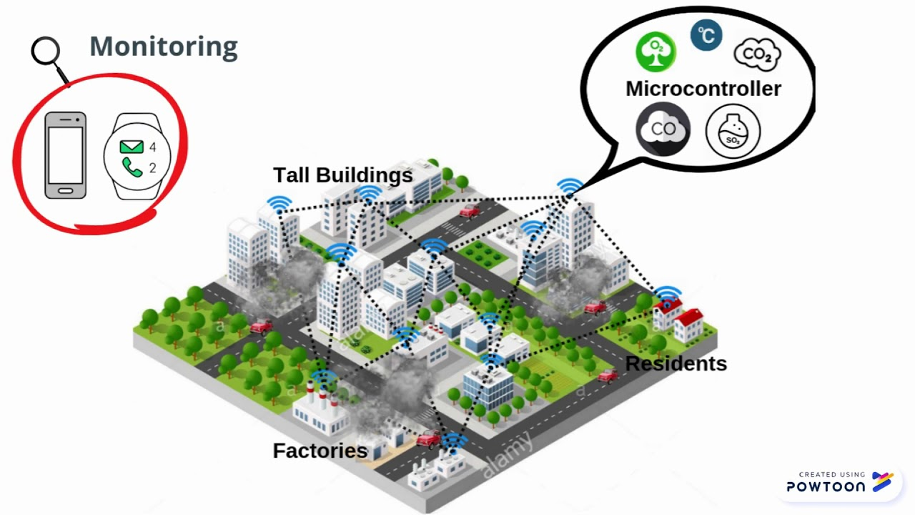
People working in mining area are at a risk sudden exposure to high level of CO which is unnoticeable. Therefore, it is necessary to regularly monitor and report the hazardous impacts from air pollution.
To monitor the quality of air, a new framework is proposed that monitors the parameters of the environment around us such as CO, presence of smoke, temperature and humidity ,light intensity with the help of Bluetooth and cloud mobile app.

Slide 6

PROJECT OBJECTIVES
To measure the Atmospheric parameters such as Temperature, Humidity, Atmospheric Pressure, Air Quality, Level of Carbon Monoxide using related sensors with help of Arduino Uno.
To monitor the parameters using IOT interface such as Bluetooth App.
To improve the quality of air using Air filter.

Slide 7
LITERATURE SURVEY
Monitoring Smart City Application Using Raspberry PI based on IOT, Aishwarya R.Hujare, Namrata C Rutuja, M.Salokhe (2018), This paper focuses on design and implementation of an IOT based smart city using raspberry pi.
Smart City Battery Operated IoT Based Indoor Air Quality Monitoring System, Siavash Esfahani, pier Rollins(2020),This paper presents the design and development quality(IAQ) monitoring system. Also VOC, temperature, humidity and illuminance
A Wireless Sensor Network for Weather and Disaster Alarm Systems, Cholatip Yawut Sathapath Kilaso (2021) In this system, a wireless sensor network based on Zigbee/IEEE802.15.4 standard is utilized as a weather station network sending weather information and disasters’ alerts. The weather information is analyzed by using decision tree techniques to announce the disasters’ alerts

Slide 8


Air Quality Sensing and Reporting System Using IoT, Rohan Kumar Jha (2020) The system presented in this paper is an advanced real time air quality reporting system supported with Internet Of things (IOT) architecture. Degrading air quality has been a matter of concern nowadays and real time monitoring of air quality helps us to keep a check on it
Portable Air Purifier with Air Quality Monitoring Sensor Marin Berov Marinov, Dimitar Iliev Iliev (2019) This study presents the development and implementation of an innovative portable air purifier. The device can be used to improve air quality in small spaces.

Slide 9
BLOCK DIAGRAM
PRESSURE
SENSOR
BLUETOOTH
MODULE
TEMPERATURE
&
HUMIDITY
ARDUINO
UNO
MOBILE APP
AIR QUALITY
SENSOR
LCD DISPLAY
AIR PURIFIER
FILTER
SOLAR PANEL
BATTERY

Slide 10
METHODOLOGY
The Proposed System:
The proposed system to monitor various parameters of environment using Arduino microcontroller, bluetooth and Embedded Technology is proposed to improve quality of air.
With the use of technologies like bluetooth and Embedded System enhances the process of monitoring various aspects of environment such as air quality monitoring issue proposed in this project.
The detection and monitoring of dangerous gases is taken into account in a serious manner and related precautions have been considered and displayed in LCD.
It is estimated that this system will have a great acceptance in the market as it is a centralized system for a complete monitoring function.

Slide 11

It uses real time bluetooth wireless protocol devices with smart phone.
This monitoring system can be enhanced by adding wireless network card for storage of values from sensors attached to microcontroller as well as more gas sensors could be used like, CO.
Another aspect of measuring particulate matter
can be introduced to make it more advanced.

Slide 12
AIR QUALITY PARAMETERS:
The important parameters that are considered in the proposed framework include:
CO is odourless, colourless, tasteless and highly poisonous gas. It is released when fuel in engine does not burn properly and road traffic is the primary source of 91% of all CO emissions.
In addition, after combining with the haemoglobin of blood, it forms carboxyhemoglobin (HbCo) which leads to reduction in oxygen carrying capacity of blood thus causes hypoxia.
Human health is largely in danger with the exposure to 100ppm or more. Continuous exposure of CO even at low levels can cause depression, confusion, and memory loss. Carboxyhemoglobin can be reverted to haemoglobin but the recovery process is slow because of the stability of HbCo complex.
Carbon monoxide gas:

Slide 13


The optimum treatment for CO poisoning although remains controversial, but providing hyperbaric oxygen therapy is considered as a treatment whether or not it provides necessary results . Half-life of CO gets shortens from 320 minutes to 80 minutes on normal air by managing oxygen via non-rebreather mask.

Slide 14
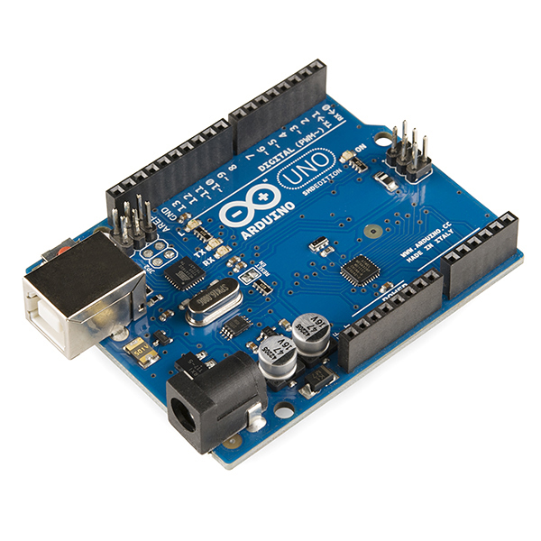
ARDUINO UNO
The Arduino Uno is an open-source microcontroller board based on the Microchip ATmega328P microcontroller and developed by Arduino.cc.
The board is equipped with sets of digital and analog input/output (I/O) pins that may be interfaced to various expansion boards (shields) and other circuits.

Slide 15
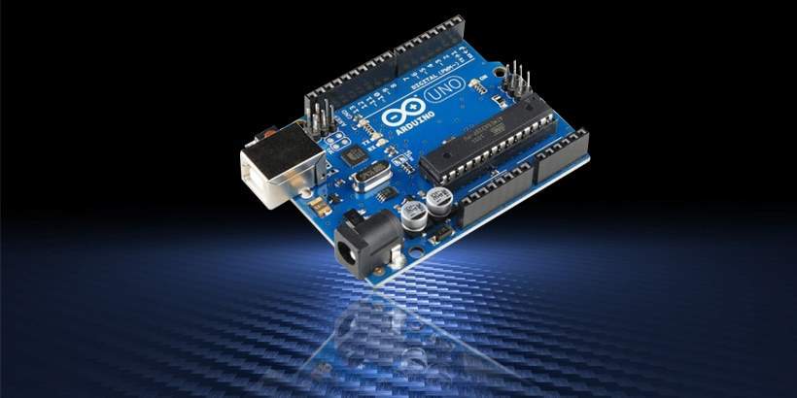
The board has 14 digital I/O pins (six capable of PWM output), 6 analog I/O pins, and is programmable with the Arduino IDE (Integrated Development Environment), via type B USB cable.
It can be powered by the USB cable or by an external 9-volt battery, though it accepts voltages between 7 and 20 volts. It is similar to the Arduino Nano and Leonardo.
While the Uno communicates using the original STK500 protocol, it differs from all preceding boards in that it does not use the FTDI USB-to-serial driver chip. Instead, it uses the Atmega16U2 (Atmega8U2 up to version R2) programmed as a USB-to-serial converter.

Slide 16
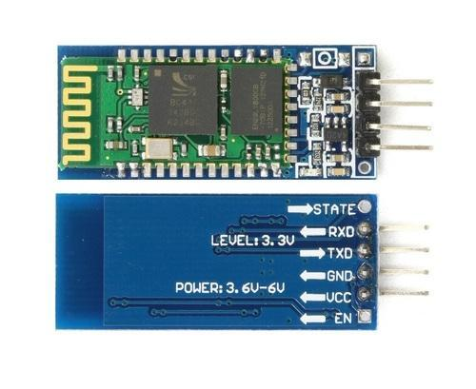
BLUETOOTH MODULE HC-06
HC-06 is the popular Bluetooth module. This HC06 module is slave mode only. It’s very easy to add wireless serial connectivity for your device with this module.
Examples for Arduino and other boards are available. Once you pair with other Bluetooth devices you work like with normal UART to exchange data.
This module has built-in 3.3V voltage regulator and helps to break out the important pins (Vcc, Gnd, Txd, Rxd). Based on CSR BC4 chip, Bluetooth V2.0 + EDR.
You can set the baud rate, name and pair password by AT commands when there is no Bluetooth connection. This module is a slave- it can be paired with Computer- Bluetooth master- mobile phone- PDA- PSP and so on.

Slide 17
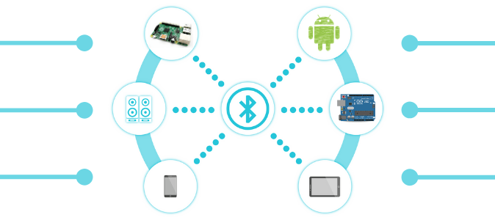
Features:
Bases at CSR BC04 Bluetooth technology.
With build-in 2.4GHz PCB antenna
It’s at the Bluetooth class 2 power level.
Operating voltage: 3.3V to 6V DC
Operating current in pairing is in the range of 30~40mA.
Operating current in communication is 8mA.
Interface via UART, default baud rate at 9600 bps
Operating temperature range: -25 °C – +75°C
Dimensions 27mm×13mm×2.2mm
Range test: <100 meters.

Slide 18
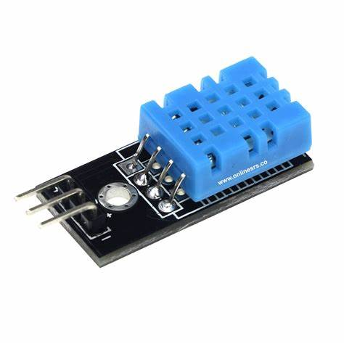
DHT11 - Temperature and Humidity Sensor Module
DHT11 is a Humidity and Temperature Sensor, which generates calibrated digital output. DHT11 can be interface with any microcontroller like Arduino, Raspberry Pi, etc. and get instantaneous results.
DHT11 is a low cost humidity and temperature sensor which provides high reliability and long term stability. It uses a capacitive humidity sensor and a thermistor to measure the surrounding air, and outputs a digital signal on the data pin (no analog input pins needed).
Its very simple to use, and libraries and sample codes are available for Arduino and Raspberry Pi. This module makes is easy to connect the DHT11 sensor to an Arduino or microcontroller as includes the pull up resistor required to use the sensor.

Slide 19
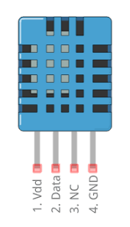
Specifications:-
Power Supply： 3.3~5.5V DC
Output： 4 pin single row
Measurement Range： Humidity 20-90%RH， Temperature 0~50℃
Accuracy： Humidity +-5%RH， Temperature +-2℃
Resolution： Humidity 1%RH， Temperature 1℃
Long-Term Stability： <+/- 1%RH/year.
Pin Description:-
Pin 1: Power +Ve (3.3VDC to 5.5VDC Max wrt.GND)
Pin 2: Serial Data Output
Pin 4: Power Ground or Power –Ve

Slide 20
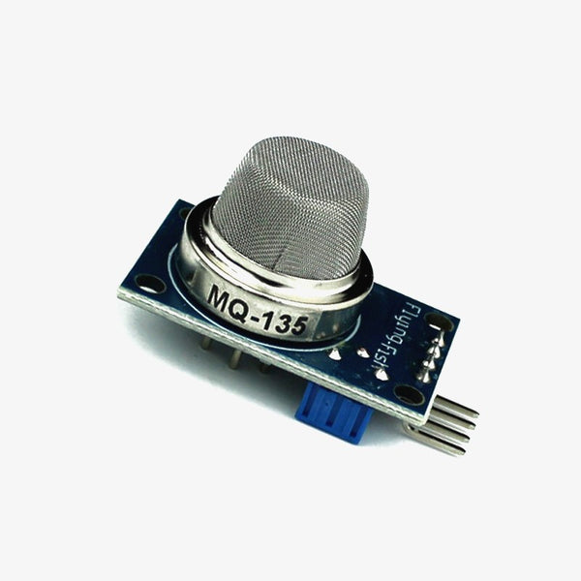
MQ135 Air Quality Sensor
The MQ-135 Gas sensor can detect gases like Ammonia (NH3), sulfur (S), Benzene (C6H6), CO, and other harmful gases and smoke.
When the level of these gases go beyond a threshold limit in the air the digital pin goes high.
This threshold value can be set by using the on-board potentiometer.
The MQ135 air quality sensor module operates at 5V and consumes around 150mA. It requires some pre-heating before it could actually give accurate results.

Slide 21

Technical Specifications of MQ135 Gas Sensor
Operating Voltage: 2.5V to 5.0V.
Power consumption: 150mA.
Detect/Measure: NH3, NOx, CO2, Alcohol, Benzene, Smoke.
Typical operating Voltage: 5V.
Digital Output: 0V to 5V (TTL Logic ) @ 5V Vcc.
Analog Output: 0-5V @ 5V Vcc.
.

Slide 22
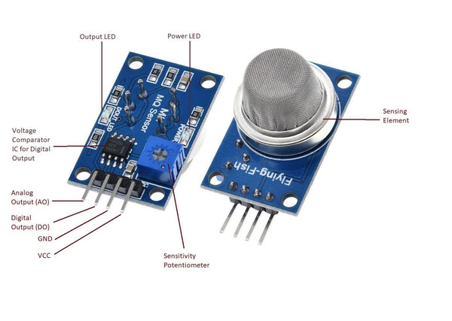
MQ 02 Carbon Monoxide Detection Sensor:
This is a robust Gas sensor suitable for sensing LPG, Smoke, Alcohol, Propane, Hydrogen, Methane and Carbon Monoxide concentrations in the air.
If you are planning on creating an indoor air quality monitoring system.
Breath checker or early fire detection system, MQ2 Gas Sensor Module is a great choice.

Slide 23
Specification Of MQ 02 Sensor
Operating voltage | 5V
Load resistance | 20 KΩ
Heater resistance | 33Ω ± 5%
Heating consumption | <800mw
Sensing Resistance | 10 KΩ – 60 KΩ
Concentration Scope | 200 – 10000ppm
Preheat Time | Over 24 hour

Slide 24
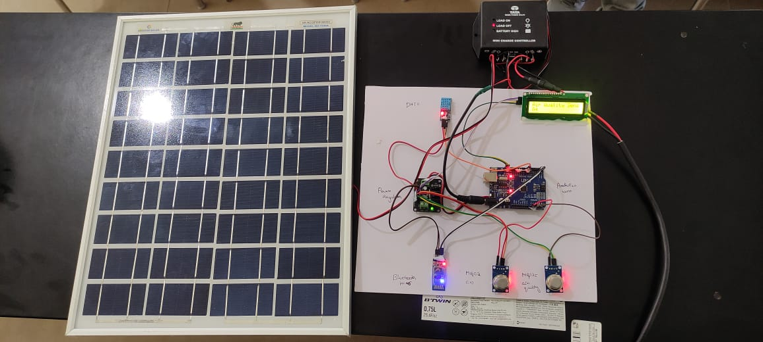
Working Model

Slide 25
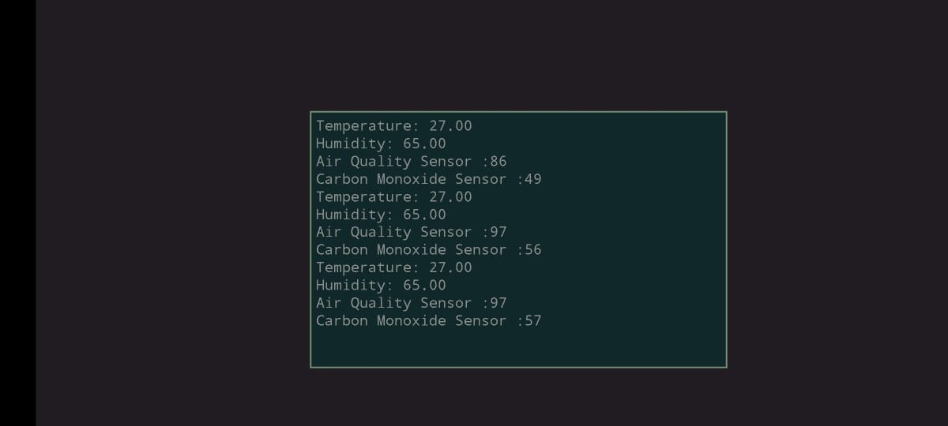
Result Output in Mobile Bluetooth APP

Slide 26
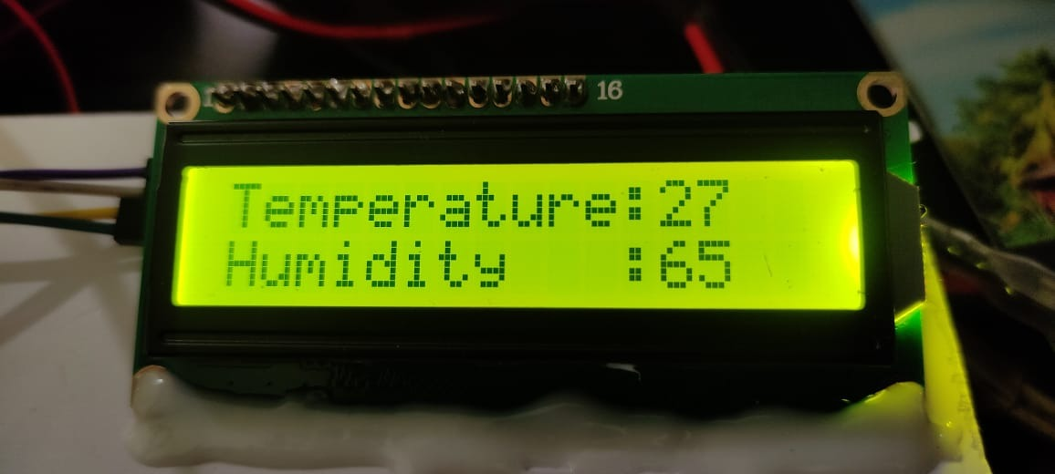
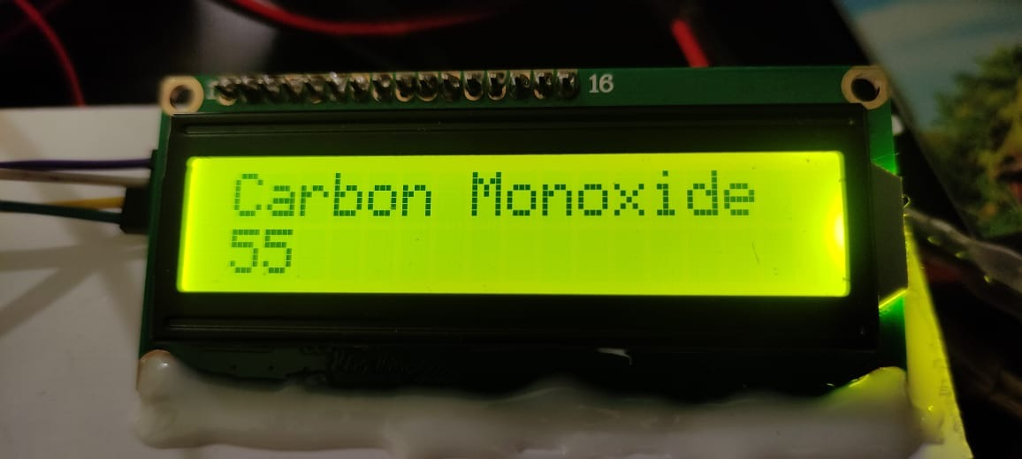
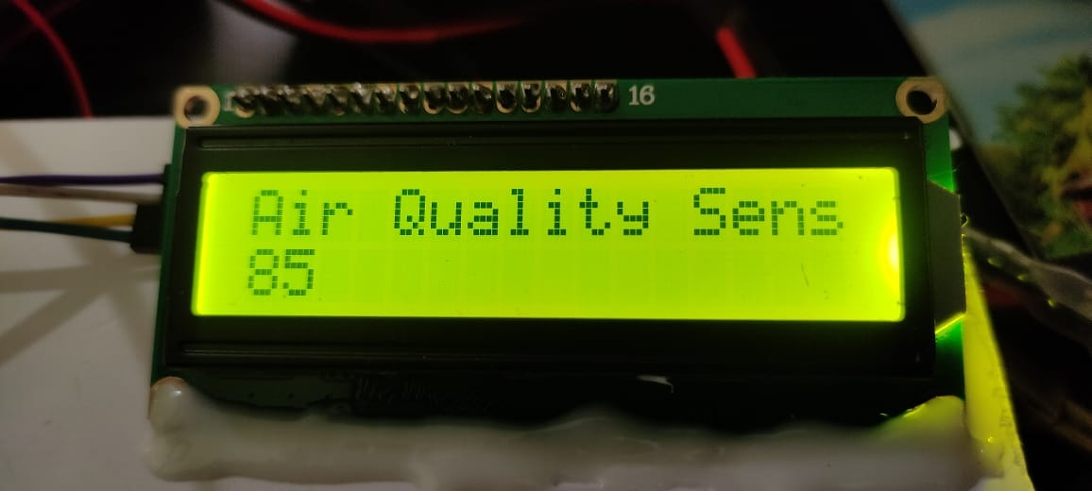
Result Output on LCD Display

Slide 27
Hardware & Software Requirements
Hardware Requirements:
Software Requirements:
SL. NO | HARDWARE | QUANTITY
1 | Arduino Uno Micro Controller | 1
2 | Air Quality Detection Sensor | 2
3 | LCD Display | 1
4 | DC Power Supply Board | 1
5 | Bluetooth | 1
6 | Smart Phone | 1
7 | Air Filter | 1
SL. NO | REQUIREMENTS
1 | Arduino Software
2 | C++

Slide 28
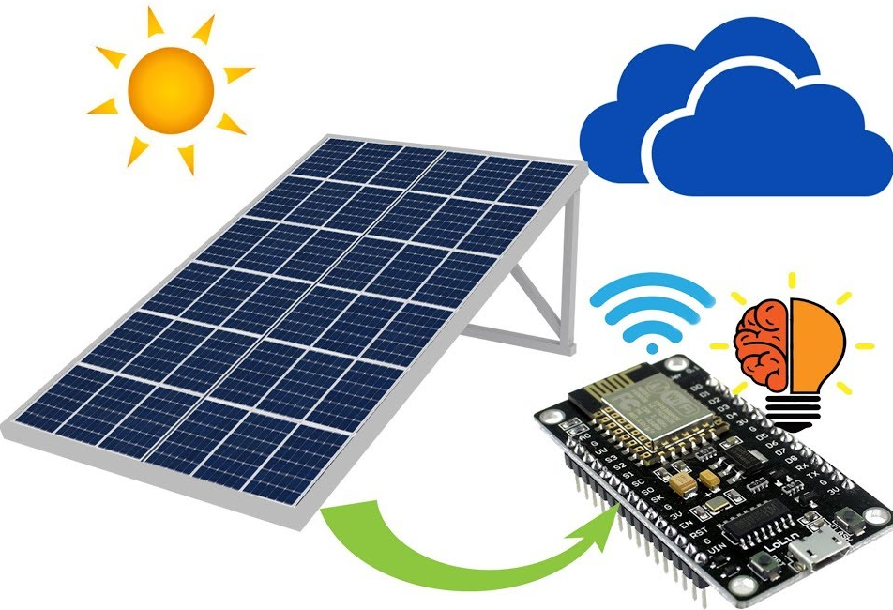
APPLICATIONS
Can be used in R & D centers.
Can be used in Educational Institution.
Can be used in Public spaces.
Can be used in aerospace.
Can be used in industries.

Slide 29
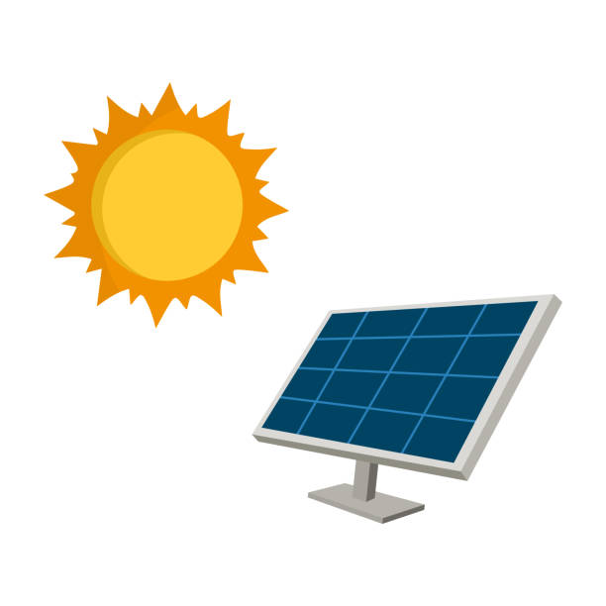
ADVANTGES
Maintains good environment.
Avoid dieses spread for people Save human life from disease.
Save property damage from dangerous chemical in the pollution
More Secure ,Easy to Maintain ,Low cost.
Reprogrammable……etc

Slide 30
BUDGET ESTIMATION
SL.No | Description | Budget(Rs)
1 | Hardware Components | 18000
2 | Circuit + Software | 4000
3 | Project Report | 1000
4 | Miscellaneous | 2000
 | Total | 25000

Slide 31
REFERENCES
[1] Prof S. A. Shaikh1, Suvarna A. Sonawane2, ”Monitoring Smart City Application Using Raspberry PI based on IoT” International Journal of Innovative Science, Engineering & Technology, Vol 5 Issue VIL, July 2017.
[2] Prof Muragesh SK1, Santhosha Rao2, “Automated Internet of Things For Underground Drainage and Manhole Monitoring Systems For Metropolitan Cities.” International Journal of Innovative Science, Engineering & Technology, Vol. 2 Issue 4, June 2015.
[3] Lazarescu, M.T., "Design of a WSN Platform for Long-Term Environmental Monitoring for IoT Applications," Emerging and Selected Topics in Circuits And Systems, IEEE Journal on, vol.3, no.1, pp.45, 54, March 2013.
[4] Brown, Eric (13 September 2016).”Who need the Internet of things” .Linux.com. Retrieved 23 October 2016.

Slide 32
[5] Wemer-Allen, G., Johnson, J., Ruize, M., Less, J., and Welsh, Matt “Monitoring Volcanic Eruptions with a Wireless sensor Network. (ISSN: 2321 – 5658) Volume 01– Issue 04, December 2013 Asian Online Journals
[6] Basha, D. and Rus, D. “Design of Early Warning Flood Detection System for developing countries. Proceeding of the conference on ICTD, Bonsalove, India. Pp 1- 10, 2007.
[7] Yuwat, C. and Kilaso, S. “ A Wireless Sensor Network for Weather and Disaster Alarm System” , IPCSIT Vol. 6, Singapore. Pp 1 – 5, 201

Slide 33
THANK YOU

